Slide 1

Trivox – Conversational AI for Phones
Major Project (23ONMCR-753) Master of Computer Applications – Fourth Semester Batch: July 2023 – Session 2023–2025
Prepared by: Tripti Pandey University ID: O23MCA110288
Centre for Distance & Online Education Chandigarh University

Slide 2
Objectives of the Major Project
Develop Practical Skills: Gain hands-on experience in software testing by applying industry-standard tools and techniques to solve real-world problems.
Bridge Theory and Practice: Integrate concepts learned in previous semesters with practical project work, enhancing both technical and analytical abilities.
Comprehensive Documentation: Prepare complete project documentation, including Software Requirements Specification (SRS), modeling, development, and implementation strategies.
Industry Relevance: Focus on solutions applicable to current challenges in computer science, IT, and software engineering domains.
Independent Project Execution: Undertake the project individually, demonstrating initiative, problem-solving skills, and project management capabilities.

Slide 3
Hardware & Software Requirements
Hardware Requirements
Pentium-IV processor or above
Minimum 2GB RAM
40GB Hard Disk
Graphics card (recommended)
Additional interfaces as needed
Software Requirements
Front-end Tools: (Specify the IDE or software used for designing the user interface, e.g., Visual Studio Code, Eclipse)
Back-end/Database: (Mention the database or storage solution, e.g., MySQL, MongoDB)
Programming Language: (State the main coding language, e.g., Python, Java, C#)
Internet Technologies: TCP/IP, FTP, Telnet, SMTP, Java, RMI, CORBA, Swing, JSP, Servlets
Operating Systems: Windows 10/8/7/XP/Vista, UNIX, Linux, Android
These requirements ensure the project is developed using up-to-date technology and is compatible with current industry standards.

Slide 4
Broad Areas of Applications
Mobile Application Development: Testing mobile apps for functionality, usability, and performance across various platforms and devices.
Machine Learning: Validating data-driven models and algorithms to ensure accuracy, reliability, and scalability.
Software Engineering: Applying structured testing methodologies to enhance software quality and maintainability in diverse engineering projects.
Database Management Systems: Design, development, and testing of robust systems to store, retrieve, and manage data efficiently.
Computer Communication & Networking: Ensuring the reliability and security of data transmission across networks through comprehensive software testing.
These broad areas reflect the dynamic and interdisciplinary scope of software testing in today’s technology-driven world.

Slide 5
Major Project Guidelines
To ensure academic integrity and quality, each student must complete the major project individually. Duplicate reports are strictly not accepted. You are required to submit a comprehensive soft copy of your project, including source code, executable files, detailed documentation, and your presentation. Evaluation will be conducted by both internal and external examiners, and you must demonstrate your project on the university-specified date. Timely submission is mandatory for successful completion.

Slide 6
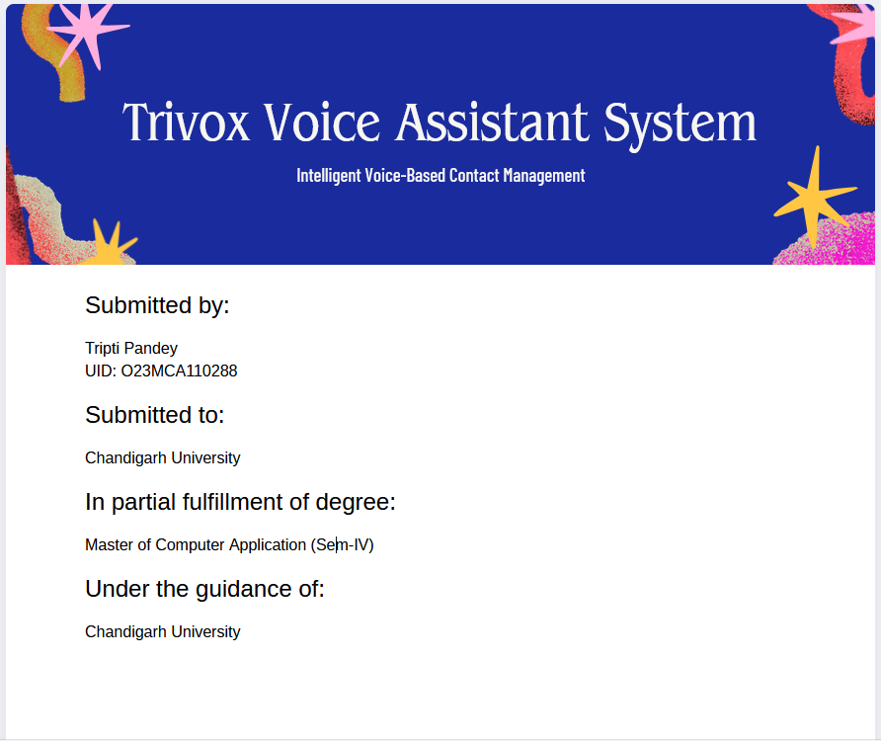

Slide 7
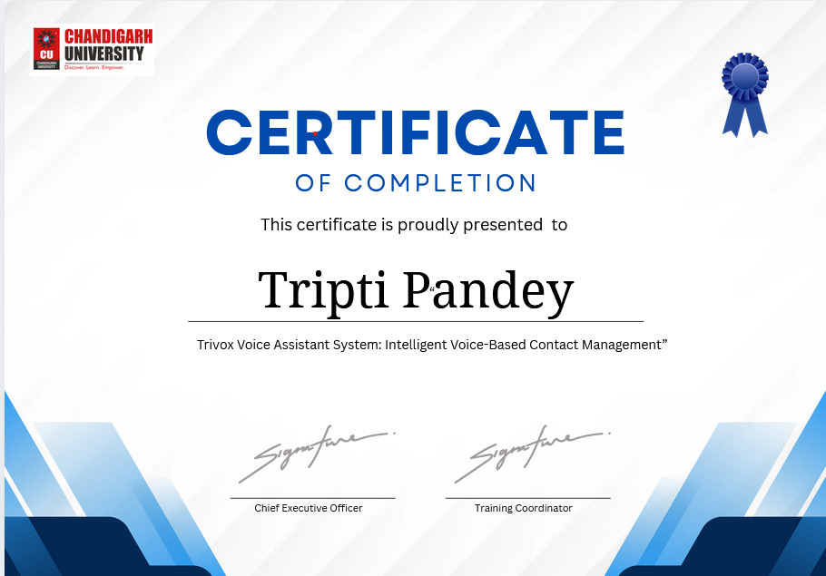

Slide 8
DECLARATION
I hereby declare that the project report entitled “Trivox Voice Assistant System: Intelligent Voice-Based Contact Management” submitted in partial fulfillment of the requirements for the degree of Master of Computer Application (Sem-IV) at Chandigarh University is my original work and has not been submitted previously by me or any other person for any degree or diploma at any university or institution.
I further declare that all the information and data presented in this report are genuine and have been obtained and presented as per academic rules and ethical standards.
Tripti Pandey UID: O23MCA110288

Slide 9
ACKNOWLEDGEMENT
I would like to express my sincere gratitude to Chandigarh University for providing me the opportunity to undertake this project, “Trivox Voice Assistant System: Intelligent Voice-Based Contact Management.”
I am deeply thankful to my project guide, , whose valuable guidance, encouragement, and support have been instrumental throughout the course of this project. Their insightful feedback and expert advice helped me overcome challenges and complete this work successfully.
I also extend my thanks to all the faculty members and My Teammate Swaraj Landge of the Master of Computer Application department for their continuous support and for providing the necessary resources and environment conducive to learning.
Finally, I would like to thank my family and friends for their constant motivation and encouragement throughout my academic journey.
Tripti Pandey UID: O23MCA110288

Slide 10
ABSTRACT
The Trivox Voice Assistant System is an intelligent voice-based application designed to simplify contact management through natural speech interaction. This project aims to develop a user-friendly voice assistant capable of recognizing and authenticating users via voice commands, interpreting various contact-related instructions, and providing seamless access to contact information. Leveraging technologies such as speech recognition APIs and a contacts database, Trivox enhances user experience by enabling hands-free operations like searching, calling, and managing contacts efficiently.
The system is structured with multiple layers of processing, including voice recognition and authentication, command interpretation, contact handling, and response generation, ensuring accuracy and security. The project demonstrates the integration of voice authentication to protect user data and employs robust command validation to handle different user requests effectively. This voice assistant can be deployed in various environments, improving accessibility and productivity for users who prefer voice interaction over traditional manual methods.
Overall, Trivox represents a significant step towards more natural and secure human-computer interaction in contact management, making communication easier and more intuitive.

Slide 11
Table of Contents
Introduction
Literature Review
System Analysis
System Design
Implementation
Testing
Results & Discussion
Conclusion & Future Work
References
Appendices

Slide 12
Introduction
In today’s fast-paced world, voice assistants have become an integral part of our daily lives, enabling hands-free interaction with technology. The Trivox Voice Assistant System is designed to simplify contact management by allowing users to perform tasks such as searching, calling, and managing contacts through natural voice commands. This system leverages advanced speech recognition and voice authentication technologies to provide a secure and user-friendly experience.
The primary goal of Trivox is to enhance accessibility and convenience, especially for users who prefer voice interaction over traditional manual methods. By integrating with external contact databases and speech APIs, the system ensures accurate command interpretation and efficient response generation. This project focuses on building a robust architecture that supports secure voice authentication, intelligent command processing, and seamless contact handling.
Overall, Trivox aims to improve communication efficiency and offer an intuitive interface for managing contacts, making it a valuable tool for both everyday users and professionals.

Slide 13
SDLC of the Trivox Voice Assistant System The development of the Trivox Voice Assistant System followed a systematic Software Development Life Cycle (SDLC) to ensure a robust, secure, and user-friendly solution. The key phases are:
1. Requirement Analysis
Gathered user needs for voice-based contact management.
Defined functional requirements such as voice recognition, authentication, command interpretation, and contact handling.
Identified non-functional requirements including security, performance, and usability.
2. System Design
Designed the system architecture, including process modules and data flow.
Created Data Flow Diagrams (DFDs) and Entity Relationship Diagrams (ERDs).
Specified integration with external services like speech APIs and contact databases.
3. Implementation
Developed modules for voice recognition, authentication, command processing, and response generation.
Integrated speech APIs and contact data handling.
Ensured modular and maintainable code structure.

Slide 14
4. Testing
Conducted unit testing for individual modules.
Performed integration and system testing to validate end-to-end functionality.
Tested for security, accuracy, and user experience.
5. Deployment
Deployed the system in a controlled environment for user acceptance testing.
Collected feedback and made necessary refinements.
6. Maintenance & Enhancement
Monitored system performance and user feedback post-deployment.
Planned for future enhancements, such as multi-language support and advanced voice analytics.

Slide 15



Trivox Assistant
PRESENTED TO
PRESENTED BY
Chandigarh University
Tripti Pandey
AI Voice-Controlled Phone
Your Phone, Your Voice, No Hands Needed!

Slide 16




Current Challenges
Smartphones today are often inaccessible during everyday tasks, such as driving or cooking, leading to security risks from unauthorized access.

Slide 17



Unique Features
ZERO-TOUCH CONTROL
Make calls, take photos, and send messages using only your voice.
MILITARY-GRADE SECURITY
Auto-shutdown after failed attempts ensures your data remains safe.
CONTEXT-AWARE AI
Learns habits to enhance user experience with intelligent commands.

Slide 18


2
Lockdown Attempts
Code Efficiency
Maximum failed attempts allowed
Unlocking user-friendly, voice-controlled smartphone experience
100%
Voice Command Accuracy
Success rate of commands

Slide 19


Security Protocols Timeline
Key steps in our security approach
Attempt One
Attempt Two
Shutdown Trigger
Reboot Options
Warning issued for unauthorized access
Force shutdown initiated after second attempt
Device locks upon too many attempts
Options for reboot via hardware or voice

Slide 20







Trivox in Action: Voice Command Features

Slide 21

1,000,000
Potential User Base
Future Innovations
Projected downloads in 2025
Plans for iOS version and smart home integration
85%
User Satisfaction Rate
Anticipated positive feedback

Slide 22
500,000
Potential users impacted
Hands-Free Revolution
Assistive tech growth opportunity
Transforming technology for assistive convenience and security in daily life
95%
User satisfaction rate
Positive feedback on ease

Slide 23
Overview of Trivox UI (React + Tailwind CSS)
What is it?
A responsive single-page interface for Trivox, an AI-based trivia voice assistant, built using React and styled with Tailwind CSS.
Main Sections:
Navigation Bar
Hero Section
Features
Categories
Pricing Plans
About Section
Footer
Technologies Used Technology | Purpose
React | Component-based UI framework
Tailwind CSS | Utility-first CSS styling
Lucide Icons | For responsive menu icons

Slide 24
Header (Navigation Bar)
<header> <h1>Trivox</h1> <nav>Links: Features, Categories, Pricing, About</nav> <button>Sign Up</button> </header>
Explanation: Displays the logo and navigation links. Uses useState to toggle mobile menu on small screens. Responsive design with hidden md:flex and md:hidden.

Slide 25
Hero Section
<section className="hero">
<h2>Trivox – Your AI Voice Trivia Assistant</h2>
<p>Voice-enabled quizzes powered by AI</p>
<button>Start Now</button>
</section>
Explanation:
Catchy title and subtitle for branding.
Two call-to-action buttons: Start Now and How It Works.
Styled with gradient background for modern look

Slide 26
Features Grid
<section id="features">
<div className="grid">
<div className="card">Voice Commands</div>
<div className="card">Daily Challenges</div>
<div className="card">Smart Learning</div>
</div>
</section>
Explanation:
Describes core functionalities of Trivox.
Responsive layout using grid and shadow for cards.

Slide 27
Categories Section
<section id="categories">
<div className="grid">
<div className="card">Science</div>
<div className="card">History</div>
<div className="card">Entertainment</div>
</div>
</section>
Explanation:
Highlights popular trivia topics.
Designed as simple, uniform cards for clean UX.

Slide 28
Pricing Plans
<section id="pricing">
<div className="grid">
<div className="card">Free</div>
<div className="card">Premium</div>
<div className="card">Family</div>
</div>
</section>
Explanation:
Shows 3 tiers of subscription.
Each card includes plan name and benefits.

Slide 29
About Section
<section id="about">
<h3>About Trivox</h3>
<p>Smart learning companion powered by AI</p>
</section>
Explanation:
Tells users why Trivox exists.
Positioned after pricing to give product context.

Slide 30
Footer
<footer>
<div>Explore | Support | Trivox Info</div>
<p>© 2025 Trivox</p>
</footer>
Explanation:
Contains links for navigation and support.
Uses dark theme and responsive layout. Final Thoughts
Fully responsive for mobile and desktop.
Easily extendable (add login, quizzes, leaderboard, etc.).
Uses semantic HTML and accessible components.
Ready for integration with backend APIs or voice SDKs.

Slide 31
🔹 Trivox Key Features
🎙️ Voice Commands
Control your phone hands-free using natural language. Answer calls, open apps, and manage tasks simply by speaking.
📆 Daily Challenges
Receive daily trivia questions tailored to your interests, making learning fun and effortless every day.
🧠 Smart Learning
Trivox learns over time, understanding your strengths and weaknesses to deliver personalized challenges and reminders.
📊 User Stats Display (Example)
42 Questions Answered
7-Day Streak
87% Accuracy

Slide 32
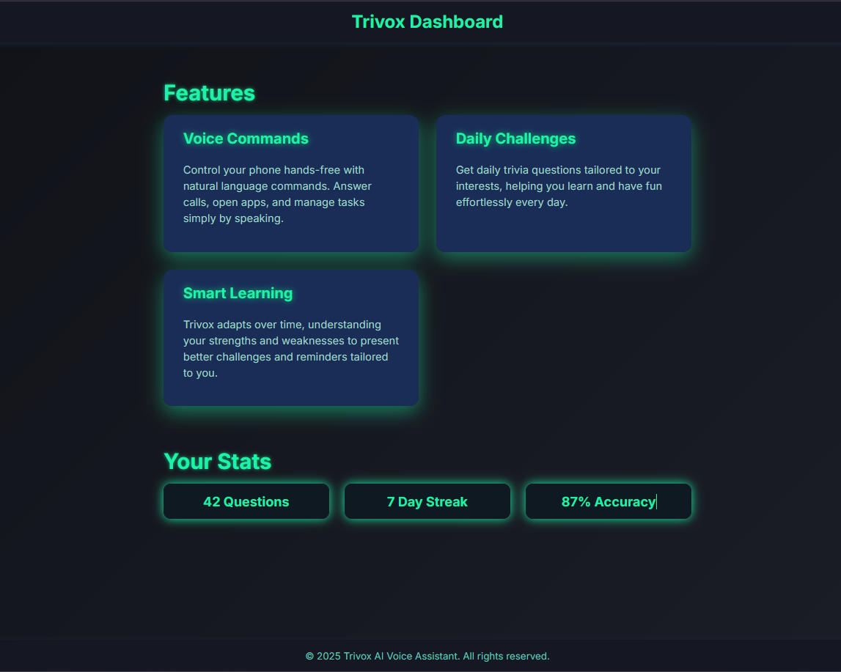

Slide 33
🎤 Trivox Voice Assistant – Demo Feature
The Trivox Voice Assistant Demo allows users to experience hands-free interaction with their device using voice commands.
Users simply press the “Start Listening” button to activate the voice interface.
Once activated, Trivox listens for spoken commands and performs tasks like answering calls, opening apps, setting reminders, or launching trivia challenges.
It provides a seamless and intuitive way to interact with your phone, especially useful while driving, cooking, or multitasking.
This demo showcases the core AI-powered speech recognition engine that underpins Trivox’s smart assistant capabilities.
If a browser does not support the required Web Speech API, users are notified gracefully, ensuring a smooth fallback experience.
Ideal For: Accessibility users, multitaskers, and anyone looking to operate their device without touching the screen.

Slide 34
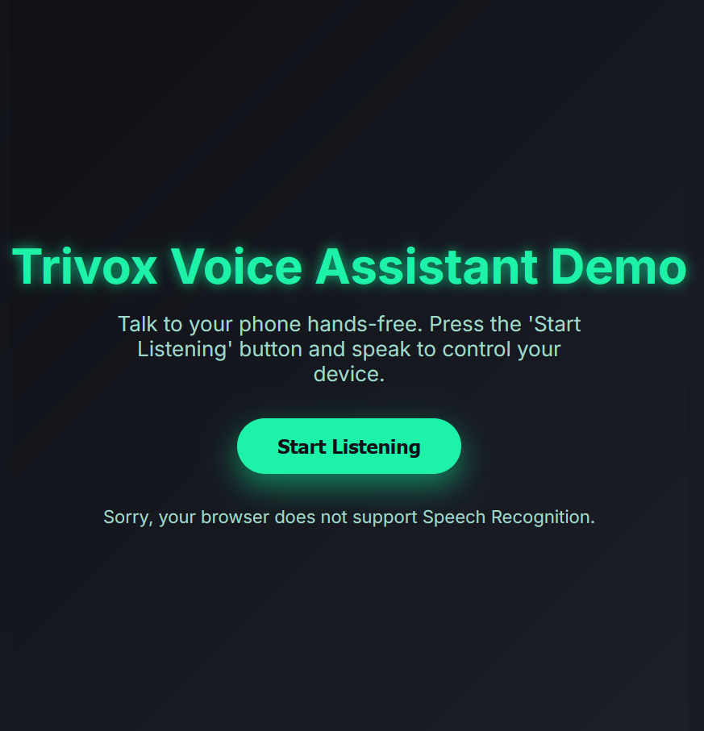

Slide 35
Advanced Features of Trivox
Continuous Listening: The assistant automatically restarts listening, so users don’t need to press the button for each command.
Intelligent Command Recognition: Utilizes fuzzy matching to accurately interpret spoken commands, even with minor errors or mispronunciations.
Speech Synthesis Feedback: The assistant provides voice confirmation for every action, ensuring clarity and confidence.
Dynamic Command Addition: Users can add new commands instantly using just their voice, enhancing flexibility and customization.
Command History with Undo: Easily revert the last action by simply saying “undo,” making corrections effortless.
Microphone Permission Handling: Clear, intuitive UI feedback keeps users informed about microphone access status.
Animated Feedback: Engaging loading and listening animations on the button improve user interaction.
Customizable Responses: Tailor both voice and visual feedback for each command to suit user preferences.
Multi-Language Support: Default support for English (en-US), with easy options to switch languages as needed.
Visual Command Suggestions: Helpful command prompts are displayed on-screen, guiding users for a smoother experience.

Slide 36
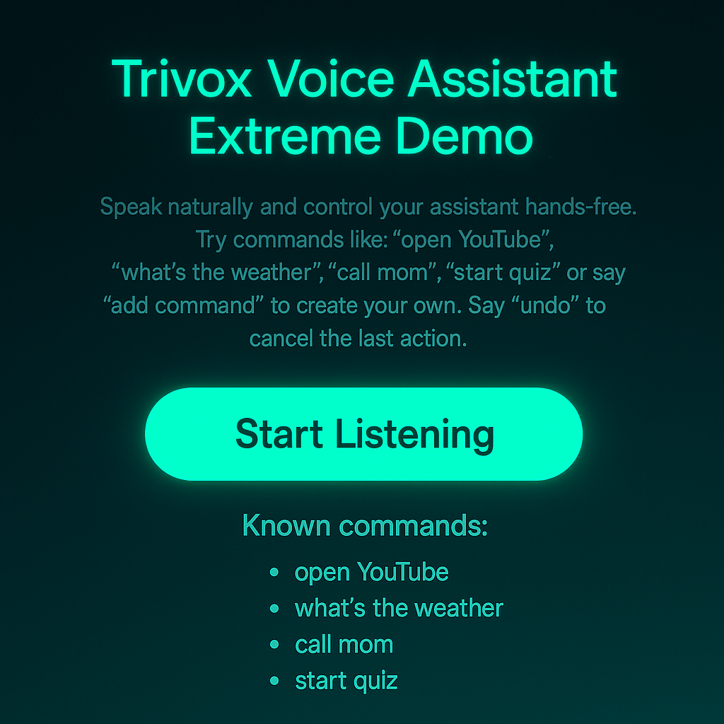

Slide 37
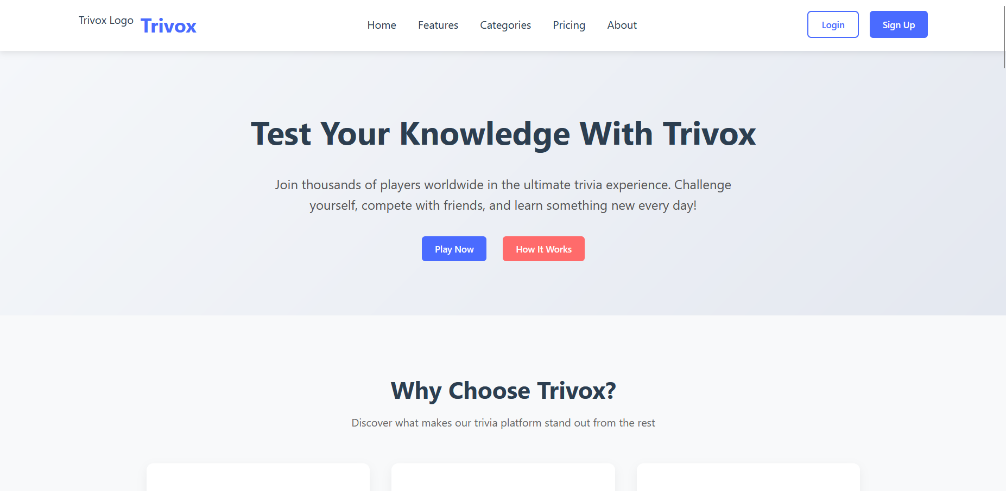
Trivox Website Interface Click here for Preview

Slide 38
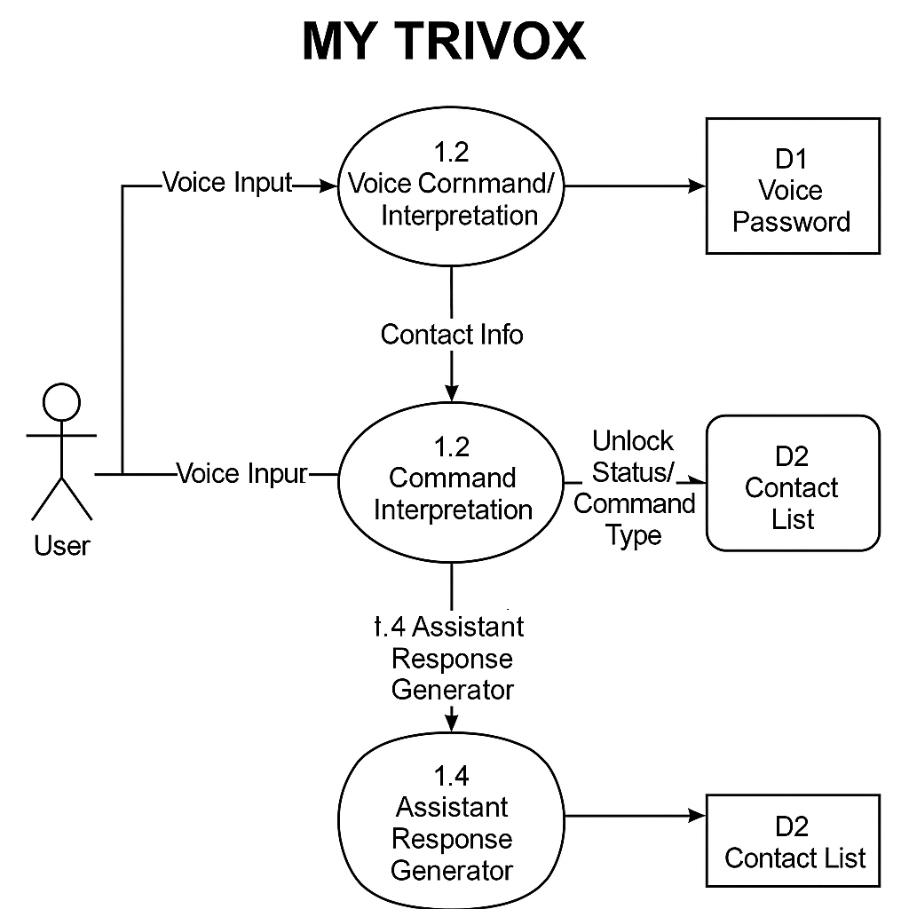
DFD Layer-1 Diagram

Slide 39
Testing Process for Trivox Voice Assistant System
The testing of the Trivox Voice Assistant System is designed to ensure high accuracy, robust performance, and an excellent user experience across a wide range of real-world scenarios. The process combines both automated and manual testing methods, focusing on the unique challenges of voice-based applications.
1. Test Planning and Preparation
Define test objectives, scenarios, and acceptance criteria for all features, including voice recognition, command interpretation, contact handling, and response generation.
Develop a gold standard dataset of user queries and expected responses, including variations in accents, dialects, and speaking styles
.
2. Automated Testing
Implement automated tests for core functionalities such as speech-to-text (STT), natural language understanding (NLU), and text-to-speech (TTS) modules
.
Use regression testing to ensure that new changes do not break existing features.
Simulate a variety of voice commands and evaluate system responses against expected outputs
.
Automate repetitive test cases to cover a wide range of scenarios quickly and efficiently
3. Manual Testing with Real Users
Conduct manual tests with users having different accents, dialects, and speaking patterns to uncover issues that automated tests might miss
.
Evaluate the assistant’s ability to understand and transcribe voice commands accurately in varied environments, including those with background noise
.
Assess the system’s ability to handle unexpected or random speech inputs gracefully and recover from errors

Slide 40
4. End-to-End (E2E) Testing
Perform E2E tests by feeding recorded or live audio queries through the entire voice assistant pipeline, from voice input to final spoken outpu
.
Compare the assistant’s responses to the gold standard dataset for accuracy and relevance.
Test integration with external APIs (e.g., Contacts Database, Speech API) to ensure seamless operation
5. Functional and Usability Testing
Verify that all intended tasks (e.g., searching, calling, managing contacts) can be completed successfully using voice commands
.
Test the clarity, naturalness, and pronunciation of the assistant’s voice responses
Check for accessibility and ease of use, ensuring the system is user-friendly for all target users.
6. Compatibility and Platform Testing
Test the application across different devices, browsers, and operating systems to ensure consistent performance and compatibility
.
7. Performance and Stress Testing
Assess the system’s responsiveness and stability under various loads and simultaneous user interactions
.
8. Error Handling and Recovery
Evaluate how the system handles miscommunications, incomplete commands, and invalid inputs.
Test the assistant’s ability to prompt users for clarification and recover from errors smoothly
.
9. Continuous Improvement
Collect feedback from users and testers to identify areas for enhancement.
Update automated and manual test cases as new features are added or issues are discovered
Summary: By combining automated scripts, manual user testing, and E2E evaluation, the Trivox Voice Assistant System ensures high reliability, accuracy, and a positive user experience, meeting the rigorous standards required for modern voice application
.

Slide 41
Conclusion
The Trivox Voice Assistant System was developed to provide an intelligent, secure, and user-friendly solution for voice-based contact management. Through the integration of advanced speech recognition, natural language processing, and robust authentication mechanisms, Trivox enables users to interact with their contact lists effortlessly and efficiently using only their voice.
The project successfully demonstrates how modern voice technologies can enhance accessibility, productivity, and convenience in everyday digital tasks. Rigorous testing ensured that the system performs reliably across different user scenarios, accents, and environments, making it adaptable for a wide range of users.
Trivox not only simplifies contact management but also sets a foundation for future enhancements, such as multi-language support, integration with other applications, and smarter AI-driven features. Overall, the project highlights the potential of voice assistants in transforming human-computer interaction, paving the way for more intuitive and inclusive digital experiences.

